Slide 1

PCCi Data Analysis

Slide 2
Content
Business Case – To identify the top features impacting the Readmit30
Data Acquisition – Past Patient health conditions ,Habits , and their visits data was obtained in CSV format
Data Preparation – Missing data was found using Azure ML and steps were taken to fill the gaps
Data Visualization – Graphs were created using Tableau understand the relation of feature to the rank

Slide 3
Data Preparation
Total number of records = 12980
duplicate records=372
No missing values were found.

Slide 4
Exploratory Data Analysis
The Features (i.e., variables) are segregated into three Categories namely:
Dependent Variable (Y) – This is the Readmit30 which is to be predicted
Noise Features : Variables which would not have a significant impact on the value of Readmit30.
Redundant
Feeder variables
Predictor Variables : Variables which were considered to have an impact on the Readmit30.

Slide 5
Exploratory Data Analysis (contd..)
Noise Variables
Predictor Variables
Admit_Week | Mood_Disorder
Admit_Month | Diabetes
Gender | Anxiety
Marital_Status | Obesity
Insurance_Provider | Dementia
Tobacco_User | Pat_Pain_Score
Depression | Care_Plan_Following_Discharge
ICU | Condition
Drug_Abuse | Bmi
Age | IP_Visits
Temperature | Chronic_Conditions
ER_Visits | Cost_Of_Initial_Stay
Weight
Height
Pulse

Slide 6
Data Visualization
Data visuals are created using Tableau where charts are plotted using the independent variables against the dependent variable (Readmit30).
These charts help us in getting a preliminary idea about the relationship between the independent variables and the dependent variable (Readmit30).

Slide 7
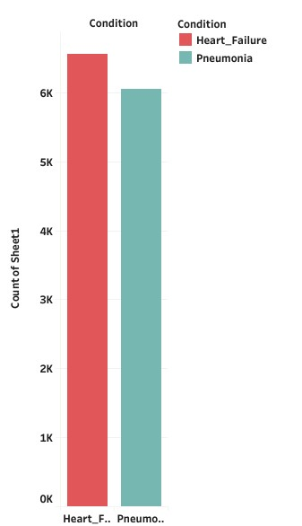
Condition Of patients.
Condition
Count %
Heart_Failure 6557 52.007%
Pneumonia 6057 47.993%
Total 12608
Key Highlights
52.007% or 6557 of Patients have Heart_Failure Condition.
47.993% or 6051 of Patients have Pneumonia condition.

Slide 8
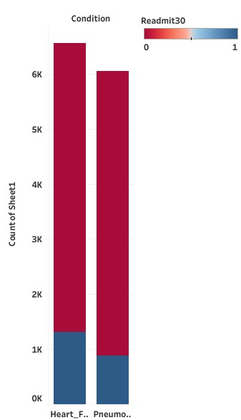
Relationship between Condition and Readmit30
Condition Vs. Readmit
Condition Readmit30 Not_Readmitted Total
Heart_Failure 1315 5242 6557
Pneumonia 884 5167 6051
Key Highlights
Out of 6557 Patients with Heart_Failure condition , 10.43% or 1315 Patients were Readmitted within 30 days and 41.58% or 5242 were not Readmited.
. Out of 6057 Patients with Pneumonia condition ,7.01% or884 Patients were Readmitted within 30 days and 40.98% or 5167 were not Readmitted.

Slide 9
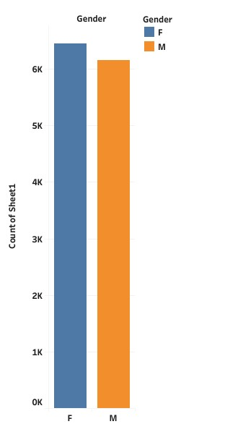
Gender
Gender
Count %
Female 6447 51.334%
Male 6161 48.886%
Total 12608
Key Highlights
Total number Of Patients =12608.
Out of 12608 Patients, 51.334% or 6447 were Female.
Out of 12608 Patients,48.886% or 6161 were Male.

Slide 10
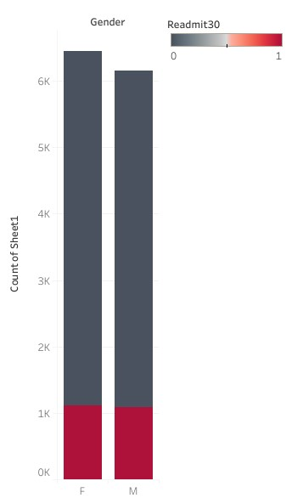
Relationship between Gender and Readmit30
Gender Vs. Readmit
Gender Readmit30 Not_Readmitted Total
Female 1114 5333 6447
Male 1085 5076 6161
Key Highlights
Out of 6447 Female Patients, 1114 or 8.84% were Readmitted within 30 days and 42.30% or 5333 were not Readmitted.
Out of 6161 Male patients,8.61% or 1085 were Readmitted within 30 days and 40.26% or 5076 were not readmitted.

Slide 11
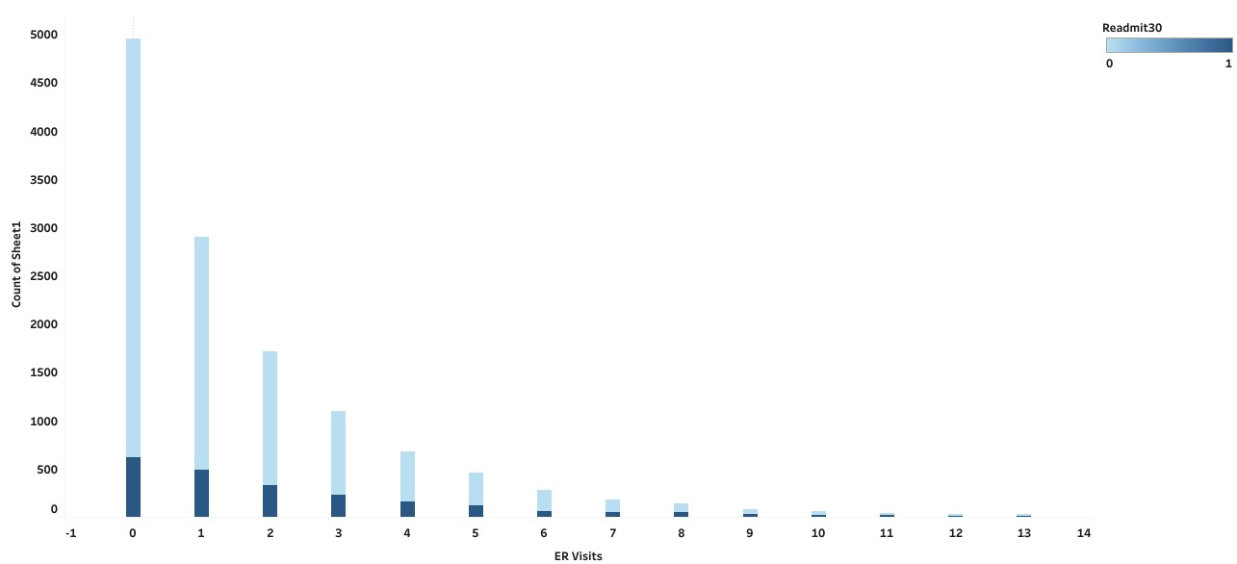
ER_Visits Vs. Readmit30.
Key Highlights
The maximum number of ER_Visits =13
Out of 39.28% or 4953 with 0 ER_Visits ,4.89% or 616 were Readmitted and 34.40% or 4337 were not Readmitted.
Out of 22.98% or 2897 with 1 ER_Visits, 3.91% or 493 were readmitted and 19.07% or 2404 were not Readmitted.
Out of 0.21% or 27 with 13 ER_Visits ,0.07% or 9 were readmitted and 0.14% or 18 were not readmitted.

Slide 12
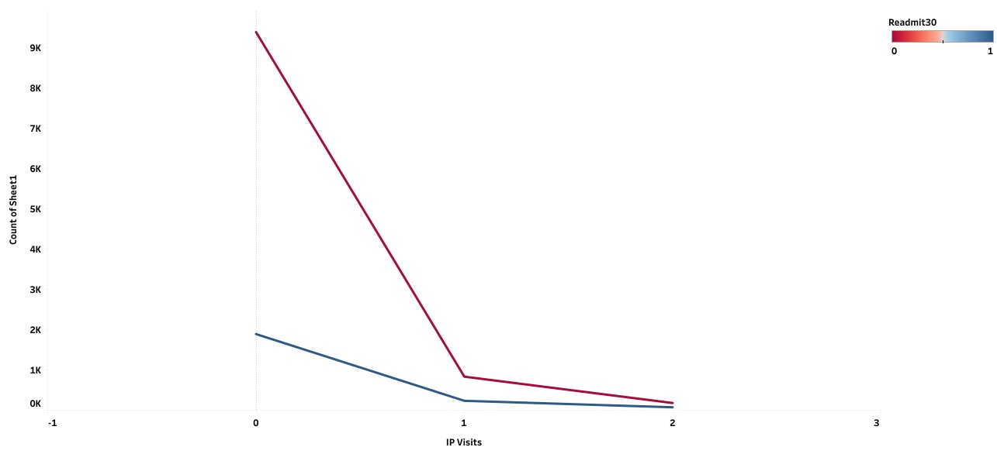
IP_Visits Vs. Readmit30
Key Highlights
The maximum number of IP_Visits= 2
Out of 89.53% or 11288 with 0 IP_Visits, 1.86% or 234 were readmitted and 6.61% or 834 were not Readmitted.
Out of 8.47% or 1068 with 1 IP_Visits ,0.07% or 9 were readmitted and 0.14% or 18 were not readmitted
Out of 2% or 252 with 2 IP_Visits,0.58% or 73 were readmitted and 1.42% or 179 were not readmitted.

Slide 13
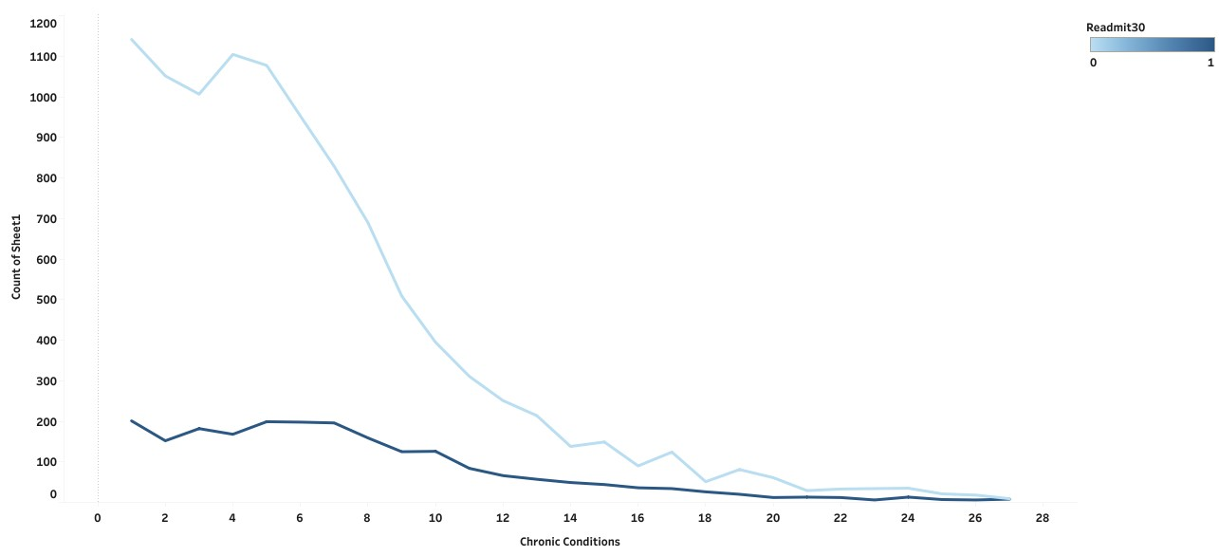
Chronic Condition Vs. Readmit30
Key Highlights
The Total no .of variant Chronic Conditions= 27
Out of 10.65% or 1343 with type 1 Chronic Condition, 1.594% or 201 were readmitted and 9.058% or 1142 were not Readmitted.
Out of 0.13% or 17 with type 27 Chronic Condition,0.071% or 9 were readmitted and 8 were not readmitted.

Slide 14
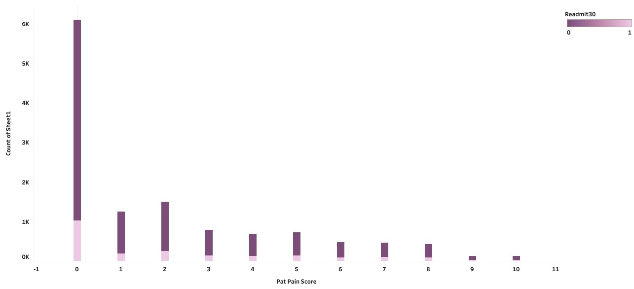
Pat_Pain_Score Vs. Readmit30
Key Highlights
Out of 48.38% or 6100 with 0 Pat_Pain_Score,8.13% or 1025 were readmitted and 40.25% or 5075 were not readmitted.
Out of 0.98% or 123 with 10 Pat_Pain_Score, 0.75% or 94 were readmitted and 0.23% or 29 were not Readmitted.

Slide 15
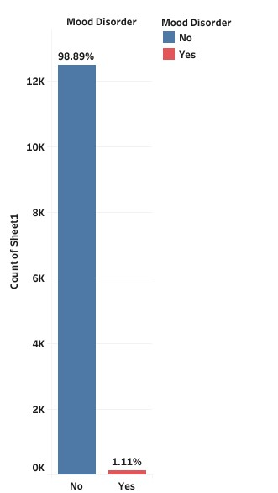
Mood Disorder
Mood Disorder
Count %
Yes 140 1.11%
No 12468 98.89%
Total 12608
Key Highlights
Out of 12608 patients , 98.89% or 12468 patients does not have Mood disorder.
Out of 12608 patients, 1.11% or 140 patients have Mood disorder.

Slide 16
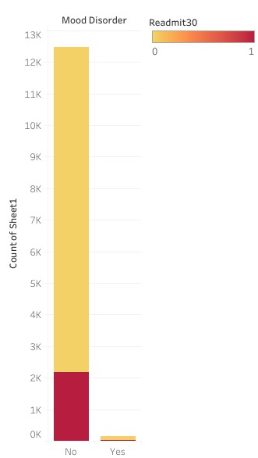
Mood Disorder Vs. Readmit30
Mood Disorder Vs. Readmit30
Mood Disorder Readmit30 Not_Readmitted Total
Yes 31 109 140
No 2168 103000 12468
Key Highlights
Out of 98.89% with no mood disorder , 17.20% or 2168 were readmitted and 81.69% or 10300 patients were not readmitted.
Out of 1.11% with mood disorder , 0.86% or 109 patients were not readmitted and 0.25% or 31 were readmitted .

Slide 17
PCCI Chi-Squared Test Analysis
Chi-Squared Test Analysis was performed to identify list of features which impact the Readmit30.
Top Numerical features impacting High School Std Score
Independent Variable
ER_Visits
Chronic_Conditions
Independent Variable
Pat_Pain_score
age
Pulse
Glucose

Slide 18
PCCI Correlation Ratio Tests Analysis
Top 3 Numerical Influencing factors on Readmit30 of PCCI are : ER_Visits, Chronic Conditions, Pat _Pain_Score
All the correlations are either weak or moderate.
Independent Variable | R (Numerical Value, Average Score 2018-2019)
ER_Visits | 0.14
Chronic_Conditions | 0.09
Pat_Pain_Score | 0.04
Age | 0.04
Pulse | 0.03
Glucose | 0.02
Bmi | 0.00

